Slide 1
Data Communications

Slide 2
Transmission
Serial Transmission
Parallel Transmission
.

Slide 3
ASYNCHRONOUS AND SYNCHRONOUS TRANSMISSION
With serial transmission, signaling elements are sent down the line one at a time.
Each signaling element may be
  Less than one bit: Example : Manchester coding.
  One bit: NRZ-L and FSK are digital and analog examples, respectively.
  More than one bit: QPSK.
.

Slide 4
ASYNCHRONOUS AND SYNCHRONOUS TRANSMISSION
The reception of digital data involves sampling the incoming signal once per bit time to determine the binary value.
In order for the receiver to sample the incoming bits properly, it must know the arrival time and duration of each bit that it receives.
.

Slide 5
ASYNCHRONOUS AND SYNCHRONOUS TRANSMISSION
If data are to be transmitted at one million bits per second (1 Mbps), then one bit will be transmitted every microsecond
The receiver will attempt to sample the medium at the center of each bit time.
At the receiver, the sampling would occur once every
If the receiver times its samples based on its own clock, then there will be a problem if the transmitter’s and receiver’s clocks are not precisely aligned.
.

Slide 6
ASYNCHRONOUS AND SYNCHRONOUS TRANSMISSION
If there is a drift of 1% (the receiver’s clock is 1% faster or slower than the transmitter’s clock), then the first sampling will be 0.01 of a bit time away from the center of the bit (center of bit is ).
After 50 or more samples, the receiver may be in error because it is sampling in the wrong bit time.
The receiver will be out of step with the transmitter if the transmitter sends a sufficiently long stream of bits and if no steps are taken to synchronize the transmitter and receiver.
.

Slide 7
ASYNCHRONOUS AND SYNCHRONOUS TRANSMISSION
Two approaches are common for achieving the desired synchronization.
Asynchronous transmission.
Synchronous transmission.
.

Slide 8
Asynchronous Transmission
This scheme avoid the timing problem by not sending long, uninterrupted streams of bits.
data are transmitted one character at a time, where each character is five to eight bits in length.
Timing or synchronization must only be maintained within each character;
The receiver has the opportunity to resynchronize at the beginning of each new character.
.

Slide 9
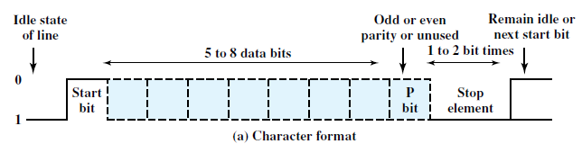
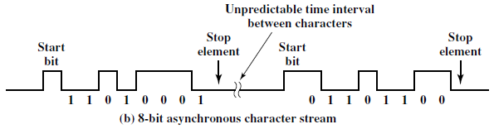
Asynchronous Transmission
Figure 6.1 Asynchronous Transmission
.

Slide 10
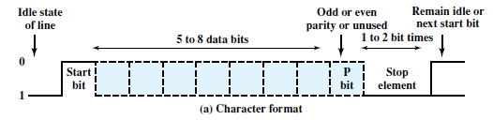
Asynchronous Transmission
When no character is being transmitted, the line is in an idle state equivalent to the signaling element for binary 1.
The beginning of a character is signaled by a start bit with a value of binary 0.
This is followed by the 5 to 8 bits that actually make up the character.
Data bits are followed by a parity bit, which is in most significant bit position.
.

Slide 11
Asynchronous Transmission
The final element is a stop element, which is a binary 1.
A minimum length for the stop element is specified, and this is usually 1, 1.5, or 2 times the duration of an ordinary bit.
The stop element is the same as the idle state, the transmitter will continue to transmit the stop element until it is ready to send the next character.
.

Slide 12
Asynchronous Transmission
The timing requirements for this scheme are modest.
If the receiver is 5% slower or faster than the transmitter, the sampling of the eighth character bit will be displaced by 45% and still be correctly sampled.
.

Slide 13
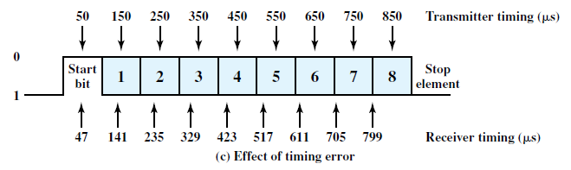
Asynchronous Transmission
Figure shows the effects of a timing error.
In this example we assume a data rate of 10,000 bits per second (10 kbps); therefore, each bit is of 0.1 millisecond (ms), or duration.
Assume that the receiver is fast by 6%, or per bit time.
Thus, the receiver samples the incoming character every (based on the transmitter’s clock). As can be seen, the last sample is erroneous
.

Slide 14
Asynchronous Transmission
An error such as just described actually results in two errors.
First, the last sampled bit is incorrectly received.
Second, the bit count may now be out of alignment.
If bit 7 is a 1 and bit 8 is a 0, bit 8 could be mistaken for a start bit.
This condition is termed a framing error.
.

Slide 15
Asynchronous Transmission
Asynchronous transmission is simple and cheap but requires an overhead of two to three bits per character.
For an 8-bit character with no parity bit, using a 1-bit-long stop element, two out of every ten bits convey no information but are there merely for synchronization; thus the overhead is 20%.
.

Slide 16
Asynchronous Transmission
The percentage overhead could be reduced by sending larger blocks of bits between the start bit and stop element.
The larger the block of bits, the greater the cumulative timing error.
To achieve greater efficiency, a different form of synchronization, known as synchronous transmission, is used.
.

Slide 17
Synchronous Transmission
With synchronous transmission, a block of bits are transmitted.
The block may be many bits in length.
To prevent timing drift between transmitter and receiver, their clocks must somehow be synchronized.
One possibility is to provide a separate clock line between transmitter and receiver.
This technique works well over short distances, but over longer distances the clock pulses are subject to impairments.
.

Slide 18
Synchronous Transmission
The other alternative is to embed the clocking information in the data signal.
For digital signals, this can be accomplished with Manchester or differential Manchester encoding.
.

Slide 19
Synchronous Transmission
With synchronous transmission, another level of synchronization required, to allow the receiver to determine the beginning and end of a block of data.
To achieve this, each block begins with a preamble bit pattern and generally ends with a postamble bit pattern.
In addition, other bits are added to the block that convey control information used in the data link control procedures.
The data plus preamble, postamble, and control information are called a frame.
.

Slide 20

Synchronous Transmission
Figure 6.2 Synchronous Frame Format
The frame starts with a preamble called a flag, which is 8 bits long.
The same flag is used as a postamble.
The receiver looks for the occurrence of the flag pattern to signal the start of a frame.
This is followed by some number of control fields (containing data link control protocol information), then a data field (variable length for most protocols), more control fields, and finally the flag is repeated.
.

Slide 21
Synchronous Transmission
For sizable blocks of data, synchronous transmission is far more efficient than asynchronous.
Asynchronous transmission requires 20% or more overhead.
The control information, preamble, and postamble in synchronous transmission are typically less than 100 bits..
.

Slide 22
Synchronous Transmission
One of the more common schemes, High Level Data Link Control (HDLC), contains 48 bits of control, preamble, and postamble.
Thus, for a 1000-character block of data, each frame consists of 48 bits of overhead and bits of data, for a percentage overhead of only
48/8048 * 100% = 0.6%.
.

Slide 23
END
.

